Slide 1
Defensive Security Project
by: Decrypters

Slide 2
Table of Contents
This document contains the following resources:
Monitoring Environment
Attack Analysis
Project Summary & Future Mitigations

Slide 3

Monitoring Environment
‹#›

Slide 4
Scenario
We are assuming the role of a Security Operations Center (SOC) analyst for a small company called Virtual Space Industries (VSI), which specializes in designing virtual-reality programs tailored for businesses.
The Situation:
VSI has received intelligence suggesting that a competitor, JobeCorp, might attempt to sabotage VSI's business operations through cyberattacks.
The goal of these attacks would be to disrupt VSI’s systems, compromising their business continuity and client trust.
The networking team has provided historical log data to assist in establishing baseline behaviors for normal system activity.
We were tasked to Build and maintain efficient Splunk workflows that:
Detect anomalies.
Generate actionable alerts.
Provide insights through dashboards and reports.

Slide 5
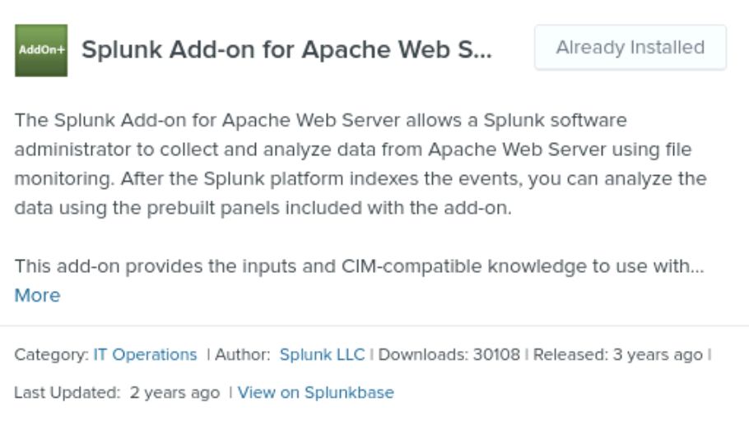
Splunk Add-on for Apache Web Server
‹#›

Slide 6
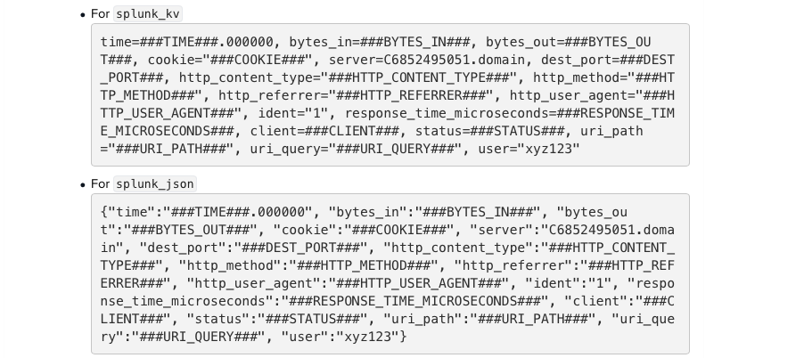
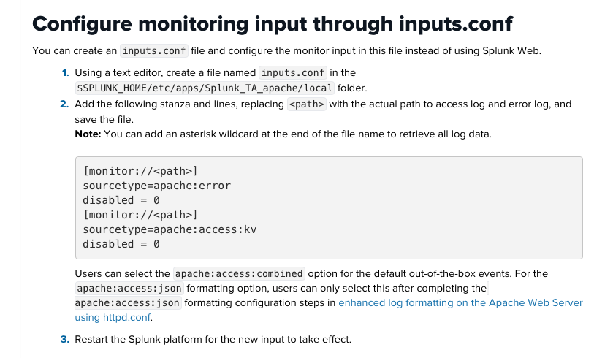
Splunk Add-on for Apache Web Server
Given that web servers are a key platform for the company, we have chosen the Splunk Add-on for Apache Web Server to enhance monitoring and analysis capabilities
Simplified Data Collection
• The add-on collects access and error logs directly from Apache web servers, ensuring seamless integration with Splunk.
• It eliminates the need for manual configuration of log forwarding or custom scripts

Slide 7
Splunk Add-on for Apache Web Server
Pre-Built Data Parsing
Reduces the need for manual regex extractions or custom field definitions
Automatically parses raw Apache logs into structured fields, such as:
IP addresses
Timestamps
HTTP methods (GET, POST, etc.)
URLs and response codes
User agents and referrers.
Security Monitoring
Facilitates analysis of potential threats like:
Malicious activity: Identifying patterns of repeated failed requests or unusual IP activity.
DoS/DDoS indicators: Monitoring surges in request volumes from specific IPs or regions.
The add-on maps Apache log data to Splunk's Common Information Model (CIM).
This enables easier correlation of web server data with other logs (e.g., security logs, application logs) for a unified analysis.
Notes:
The Splunk Add-on for Apache Web Server is a powerful tool for transforming Apache logs into actionable insights. It saves time, enhances security and performance monitoring, and integrates seamlessly with broader IT and security workflows

Slide 8
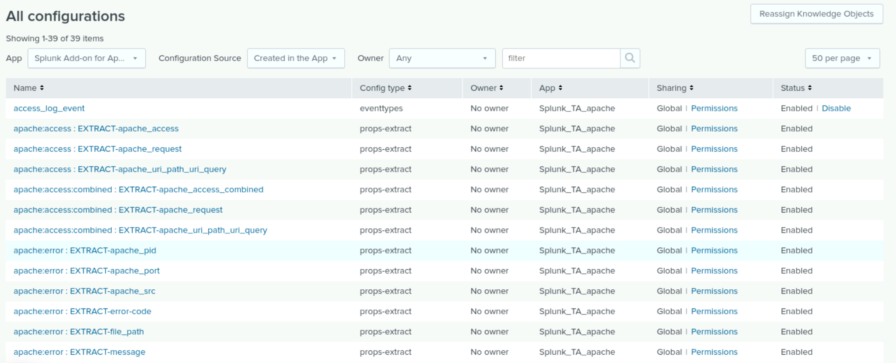
Splunk Add-on for Apache Web Server

Slide 9
Logs Analyzed
Windows Logs
Apache Logs
1
2
Windows logs provided detailed insights into system events, including security logins (successful and failed), system permissions, user names, user activities, and log-on details, helping to track unauthorized access, monitor changes, and analyze suspicious patterns for auditing and accountability.
Apache logs provided detailed information about web activity, including HTTP methods, response codes with their frequencies and usage percentages, timestamps, daily activity patterns, client IP addresses, countries of origin for requests, queried URI paths, and referrer domains to track traffic sources.

Slide 10
Windows Logs
‹#›

Slide 11
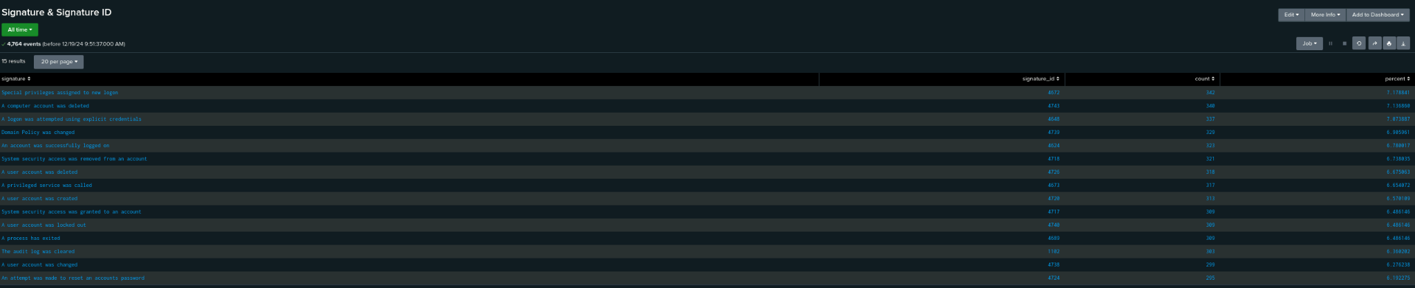
Reports—Windows
Designed the following reports:
Signatures:
Shows a table of signatures and their associated ID values
(source=”windows_server_logs.csv” host=”windows_server_logs.csv sourcetype=”csv” | top limit=20 signature signature_id)

Slide 12
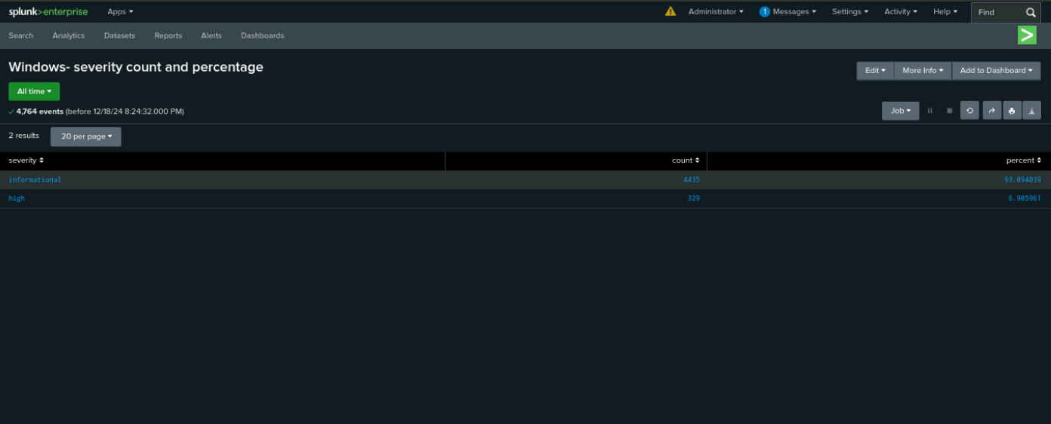
Reports—Windows
Designed the following reports:
Severity:
Shows a table with the different severity levels, with their respective count and percent. (source=”windows_server_logs.csv” host=”windows_server_logs.csv sourcetype=”csv” | top limit=20 severity)

Slide 13
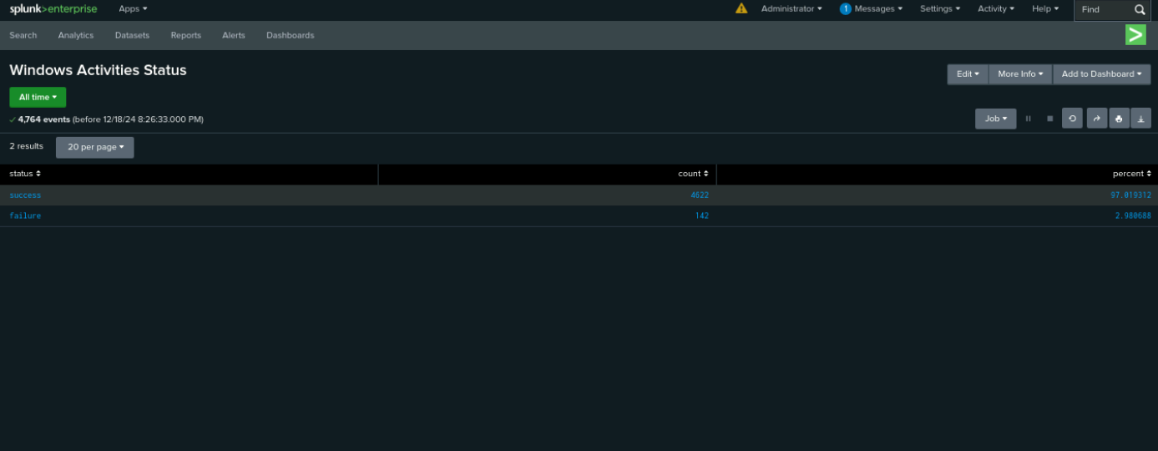
Reports—Windows
Designed the following reports:
Activity Status:
Shows a table with the two status’ (success and failure) and their respective percentages (source=”windows_server_logs.csv” host=”windows_server_logs.csv sourcetype=”csv” | top limit=20 status)

Slide 14
Alerts—Windows
Designed the following alerts:
Alert Name | Alert Description | Alert Baseline | Alert Threshold
Hourly Failed Activity | Tracking Failed Logins based on status | 6 | >15
JUSTIFICATION: During the standard logs, there were an average of 6 failure logs per hour, with a maximum of 10. Due to the chance that 11 or 12 could still be within range, we set the threshold of the alert to 15.

Slide 15
Alerts—Windows
Designed the following alerts:
Alert Name | Alert Description | Alert Baseline | Alert Threshold
Hourly Successful Log-on | Tracking Successful Logins based on signature ID | 14 | >25
JUSTIFICATION: During the standard logs, there were an average of 14 failure logs per hour, with a maximum of 21. We set the threshold of the alert to 25 to catch any excess logins per hour.

Slide 16
Alerts—Windows
Designed the following alerts:
Alert Name | Alert Description | Alert Baseline | Alert Threshold
Hourly Account Deletion | Tracking Account Deletions based on signature ID | 13 | >25
JUSTIFICATION: During the standard logs, there were an average of 13 failure logs per hour, with a maximum of 22. We set the threshold of the alert to 25 to catch any excess logins per hour.

Slide 17
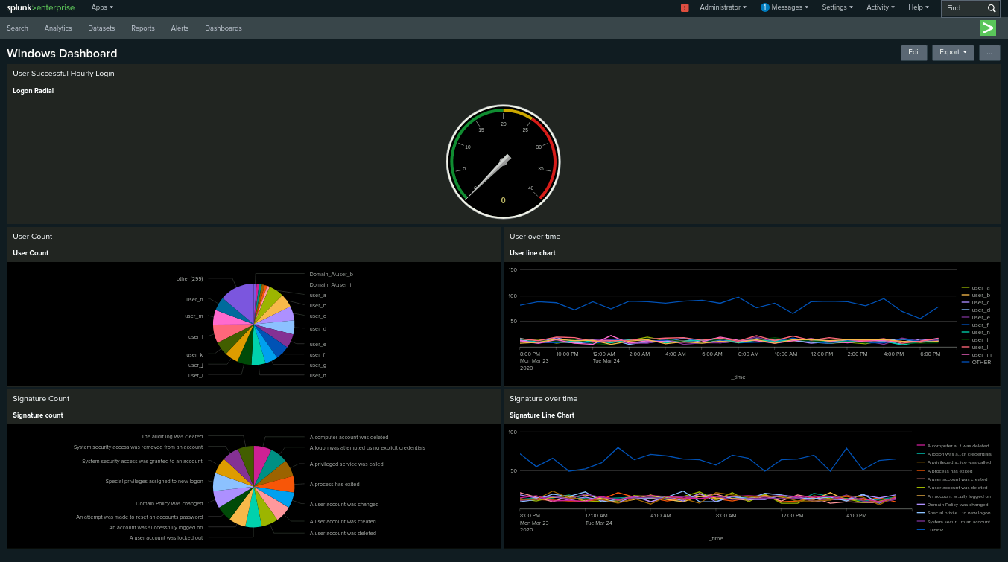
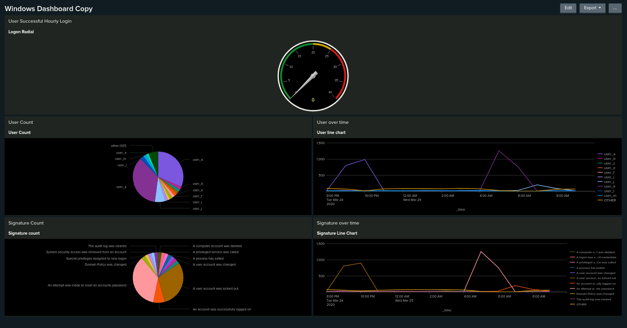
Dashboards—Windows

Slide 18
Apache Logs
‹#›

Slide 19
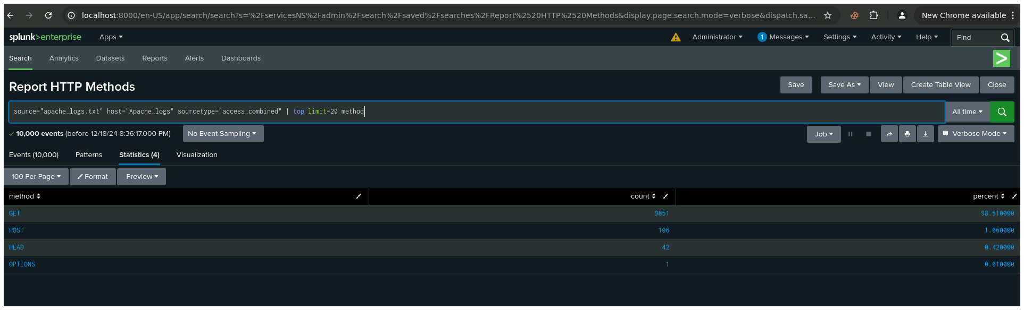
Reports—Apache
Designed the following reports:
HTTP Methods:
Shows a table of the different HTTP methods used in the logs.
(source=”apache_logs.csv” host=”apache_logs.csv sourcetype=”access_combined” | top limit=20 method)

Slide 20
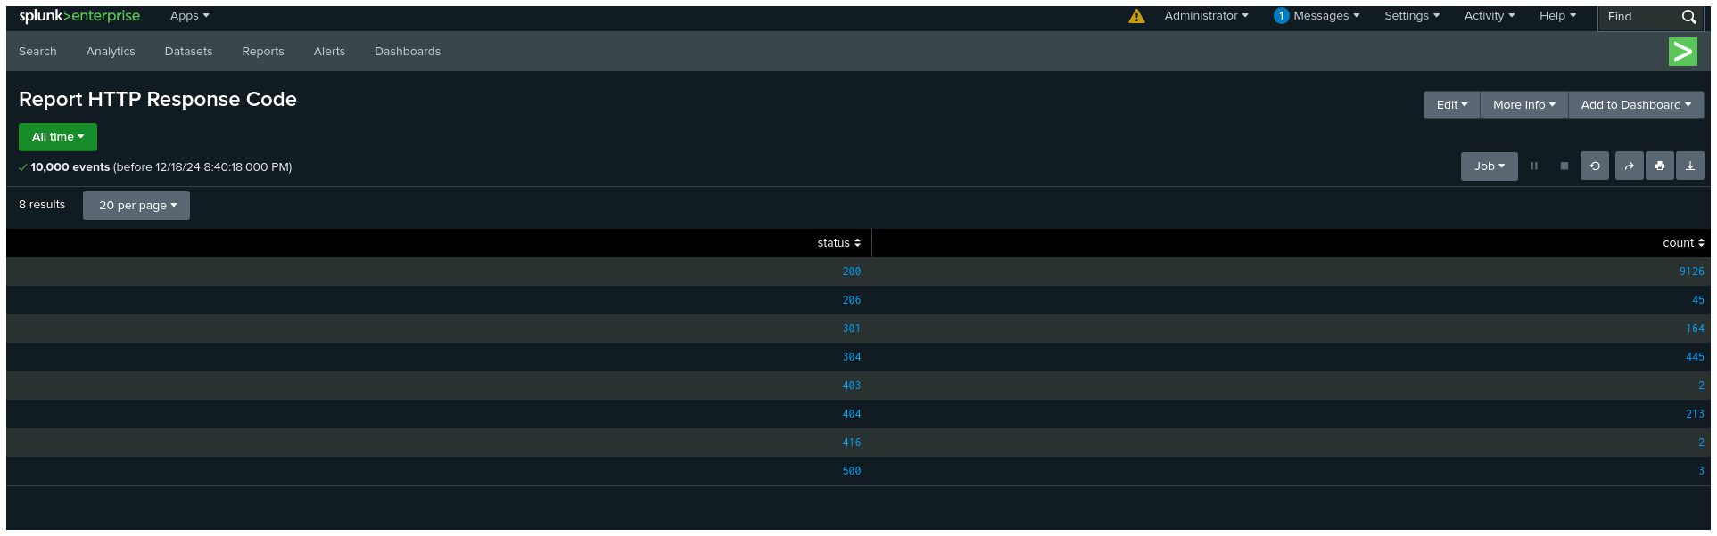
Reports—Apache
Designed the following reports:
HTTP Response Codes:
Shows a table of the of the HTTP response codes in the logs and their respective counts and percents.
(source=”apache_logs.csv” host=”apache_logs.csv sourcetype=”access_combined” | stats count by status)

Slide 21
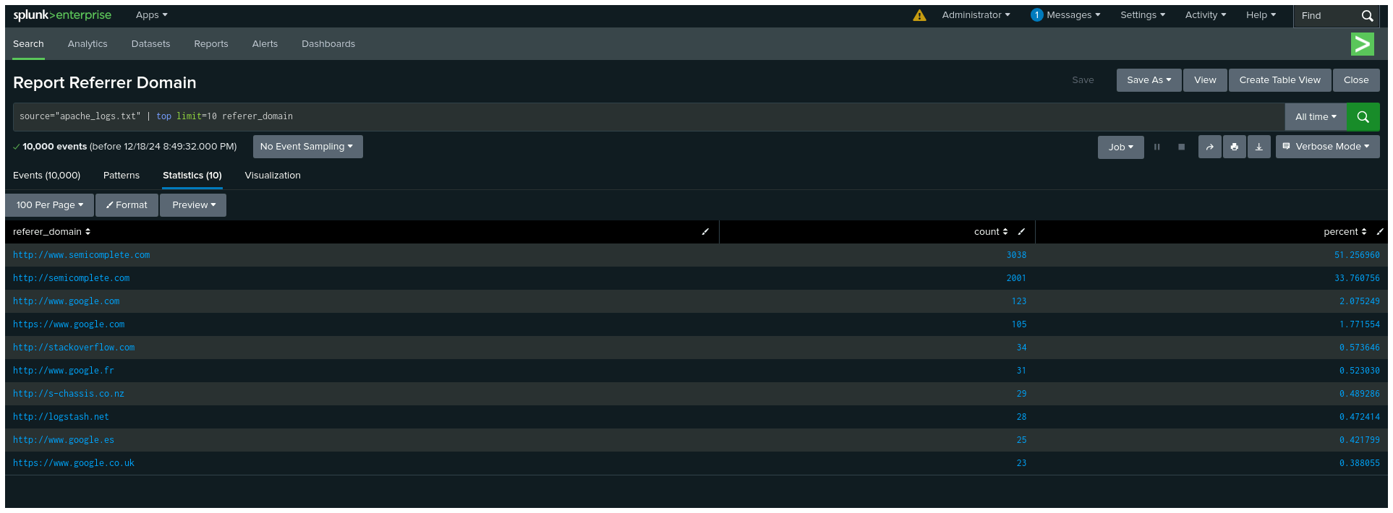
Reports—Apache
Designed the following reports:
Referer Domains:
Shows a table of the top 10 domains that referred to the VSI’s website
(source=”apache_logs.csv” host=”apache_logs.csv sourcetype=”access_combined” | top limit=10 referer_domain)

Slide 22
Alerts—Apache
Designed the following alerts:
Alert Name | Alert Description | Alert Baseline | Alert Threshold
Post Method Alert | Create alert for suspicious Post method | 6 | >10
JUSTIFICATION: We analyzed the number of Post requests and the maximum was 7. Keeping the threshold greater than 10 reduces chances of false positives.

Slide 23
Alerts—Apache
Designed the following alerts:
Alert Name | Alert Description | Alert Baseline | Alert Threshold
Non-US IPs | Alerts when users login from outside of US | 100 | >200
JUSTIFICATION: The maximum number of non-US IPs was 120 and the average was around 100, which is good for baseline. Alert threshold for 200 ensures that any suspiciously high non-US IPs are flagged while reducing chances of false positives

Slide 24
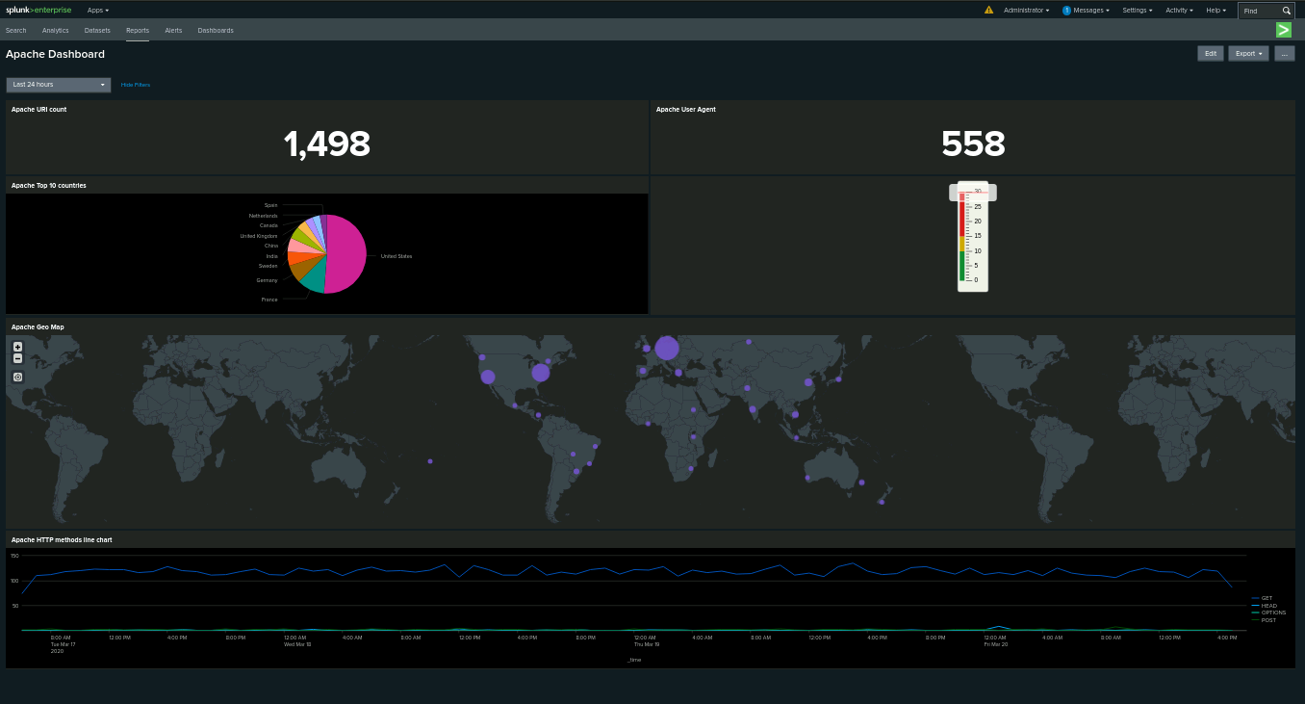
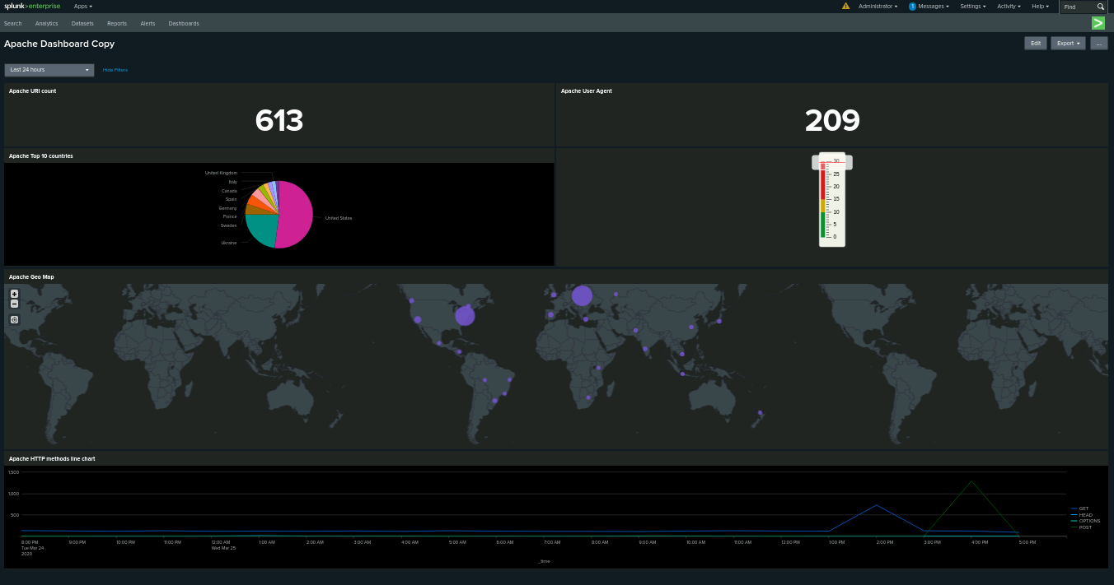
Dashboards—Apache
Place image here
Place image here

Slide 25
Attack Analysis
‹#›

Slide 26
Attack Summary—Windows
Summarize your findings from your alerts when analyzing the attack logs. Were the thresholds correct?
Events for the signature “An attempt was made to reset an account's password” increased from 6.19% to 35.7%.
Events for the signature “A user account was locked out” increased from 6.49% to 30.4%.
These trends highlight a notable escalation in suspicious activity targeting user accounts.

Slide 27
Attack Summary—Windows
the Hourly Failed Activity alert worked well, the threshold was set at >15, with the alert baseline being at 6 and there were 30+, which would have set of the alert.
the Hourly Successful Log-on also worked well, the threshold was set at >25 with the baseline being at 14, and there were 30+, which would have also triggered the alert.

Slide 28
Attack Summary—Windows
On March 24, 2020, between 8PM and 11PM, there were 1,811 instances of “A user account was locked out” for user_a
On March 25, 2020, between 4AM and 7AM, there were 2,128 instances of “An attempt was made to reset an account password” for user_k
On March 25, 2020, between 6AM and 9AM, there were 432 instances of “An account was successfully logged on” for user_j

Slide 29
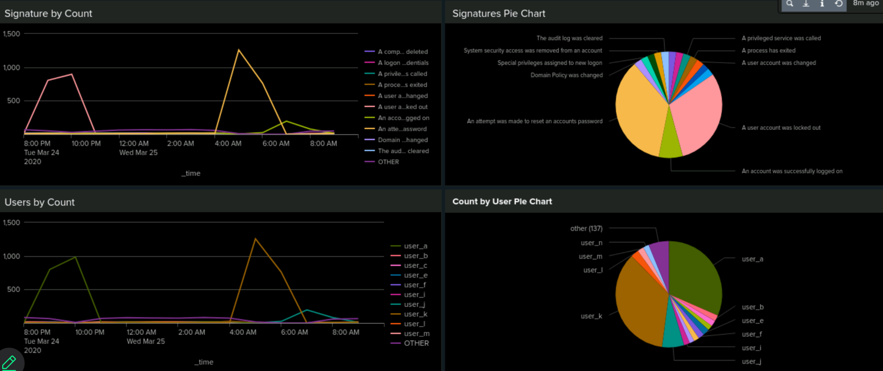
Screenshots of Attack Logs

Slide 30
Attack Summary—Apache
404 response code occurrences have surged from 213 to 679, indicating a significant rise in failed requests.
The webpage tuxradar.com has been accessed, highlighting a potential target of interest.
POST requests have increased dramatically from 1.06% to 29.4%.

Slide 31
Attack Summary—Apache
Summarize your findings from your alerts when analyzing the attack logs. Were the thresholds correct?
The non-US IP identification alert worked well. The threshold was set at >200 and there were 800+ IPs from Ukraine, which means that an alert would have been triggered
The Post method alert was also successful, as the threshold was >10 and there were 800+ Post events that occurred at 4:05:59 PM in 0.001 seconds and this alert would have been triggered as well

Slide 32
Attack Summary—Apache
On March 25, 2020, there was a spike in GET method between 1PM and 3PM
On March 25, 2020, there was a spike in POST method between 3PM and 5PM
877 POST requests were made from Ukraine, with 844 occurring at 4:05:59 PM within 0.001 seconds
The URI count was reduced to 613 from 1,498 showing a significant drop
The user agents reduced to 209 from 558, showing a significant drop
Percentage of 404 errors increased to 15% from 2.1%, showing a significant increase

Slide 33
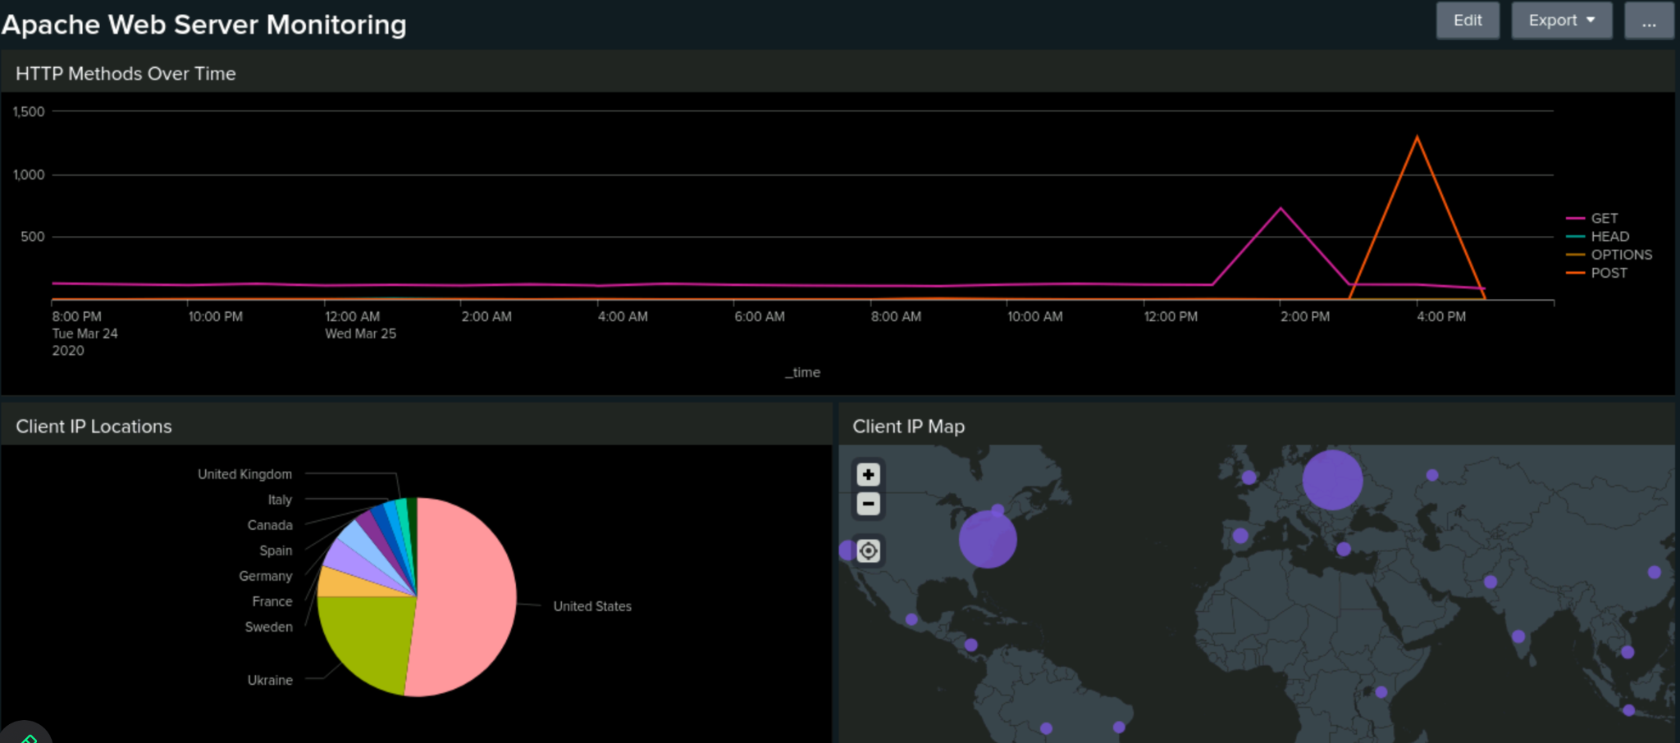

Screenshots of Attack Logs

Slide 34
Summary and Future Mitigations
‹#›

Slide 35
Project 3 Summary
What were your overall findings from the attack that took place?
The attackers successfully brute-forced their way into the company’s Windows server. This likely enabled them to open a port, which was then exploited to execute a DDOS attack on the Apache server
To protect VSI from future attacks, what future mitigations would you recommend?
Implement Multi-Factor Authentication (MFA) and enforce account lockouts after several failed login attempts to prevent brute force attacks.
Deploy IDS/IPS for real-time monitoring and automated alerts for unusual activity, such as traffic spikes.
Limit login access to US-based IP addresses to minimize the risk of unauthorized foreign access.

